Slide 1
Webinar Tech Run Through
Introductions
Controls
Agenda
Biographies
Slides
Q&A

Slide 2
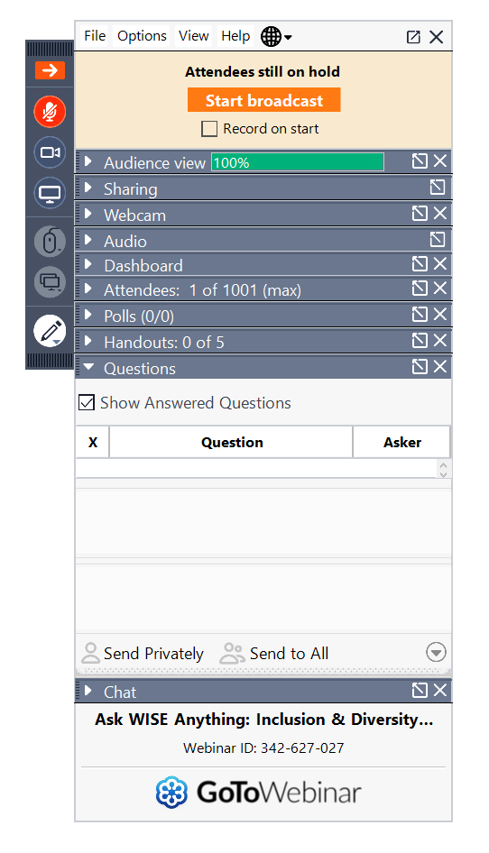
Controls
Microphone
Video
Slide control
Questions from audience
Chat

Slide 3
Agenda
11:00 – Welcome & House keeping
11:05 – Corporal Katey Rowe
11:15 – Group Captain Liz O’Sullivan
11:25 – Squadron Warrant Officer Clare Horler
11:35 – Q&A

Slide 4
The WISE webinar will begin shortly!

Slide 5
Celebrating women working in STEM on International Women’s Day, supported by RAF Engineering

Slide 6
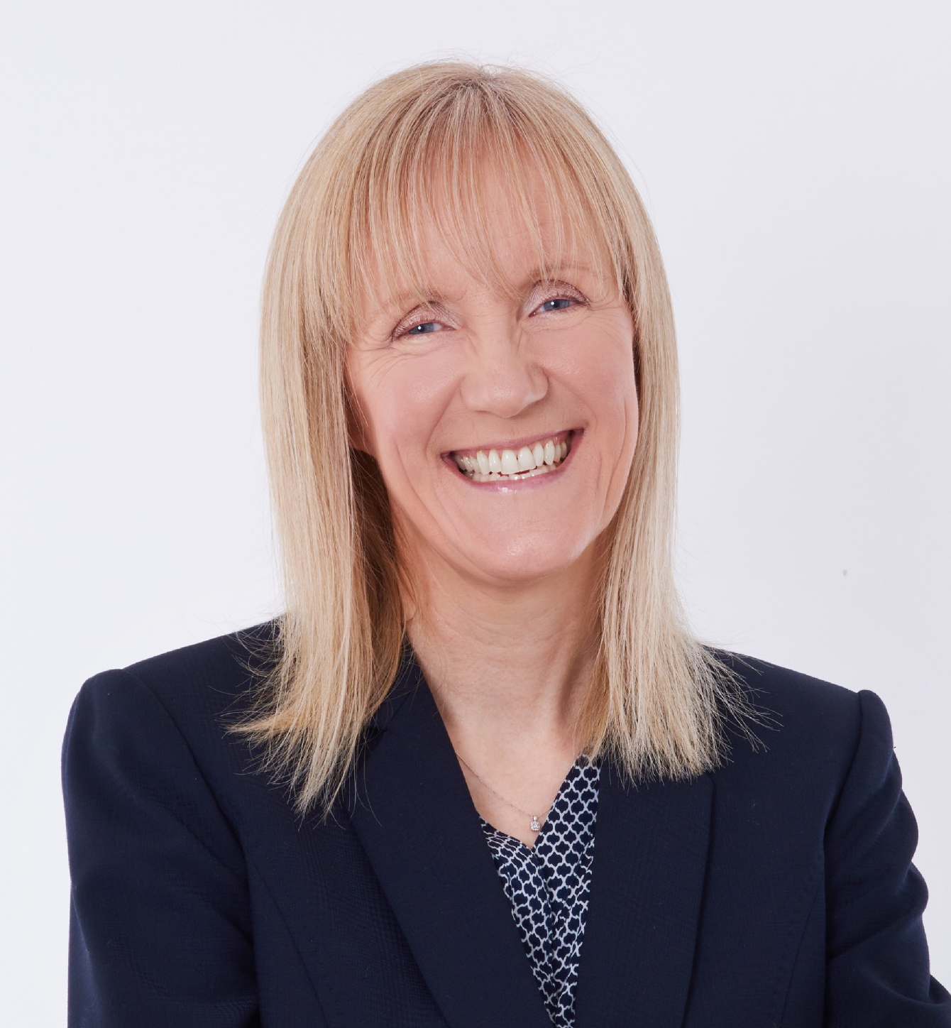
Welcome to the WISE webinar
Kay Hussain, CEO, WISE
Notes:
Just to introduce myself, my name is Kay Hussain, WISE CEO
Thanks for joining us on International Women’s Day,
Today we are very pleased to be working with the RAF to celebrate and promote the value of diversity within a workforce by showcasing talented female RAF engineers at different stages of their careers.

Slide 7
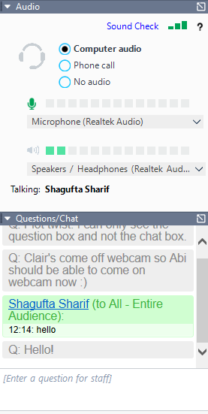
Housekeeping
Please stay muted throughout the webinar.
If your audio isn’t working, you can dial in using the ‘Phone Call’ option in the side panel.
Use the ‘question’ function in the side panel throughout to ask any questions.
Notes:
Just a few housekeeping rules before we start – please use the questions function in the side panel of GoToWebinar to ask questions throughout the session. We’ll answer them in a Q&A at the end of the session. If your audio isn’t working, you can change the computer audio settings to phone call, and it will provide you with a number for you to dial in. Please do stay muted throughout the session to avoid any background noise. Then, we like to ensure all our events and webinars are the best they can be so we do ask you to complete a short feedback survey at the end – if you do, it will be very much appreciated.

Slide 8



Who are WISE?
INSIGHT & KNOWLEDGE
Generating and sharing fresh insight and knowledge about the causes of and solutions to gender imbalance in STEM
COLLABORATE, CONNECT & AMPLIFY
Developing our members to be the leaders, role models and champions of gender balance in STEM
INSPIRATION
Inspirational events driven by member requirements
providing a platform to showcase the excellent work that is being executed in this space
Notes:
But before we start, I’d like to give you a brief introduction to WISE. We are a membership organisation with around 200 corporate members – they range from large multinationals to SMEs but also include academia (e.g. universities, colleges) and government (e.g. BEIS, GCHQ, NHS CSO) . We provide business to business networking and services to our members, partners, educators and training providers. We work with businesses to improve their gender balance through a number of different methods:-
We conduct innovative research, share this knowledge and use this to address the issues.
We conduct benchmarking through our WISE Ten Steps programme and our diagnostic tool, allowing companies to see how they compare to their competitors – asking organisations to question what they are doing to help improve their gender balance and looking at cultural change.
We offer networking opportunities through webinars, knowledge sharing events and other annual events such as the Ten Steps Measuring Progress Event and our CXO Breakfast.
Collaboration is key for us. We work with our members and other organisations to seek out best practices within the STEM sector and share these with everyone. There’s no point reinventing the wheel.
We offer training sessions in diversity and inclusion, unconscious bias, recruitment practises and outreach support through our My Skills My Life programme.

Slide 9
Introduction
Three women with a variety of RAF roles
Sharing their experiences of Engineering career opportunities and best practice
Q&A on how to attract, develop and sustain women within engineering and technological roles
Notes:
Now, we will hear from three women from a variety of roles, within the RAF who will talk about the career progression opportunities and best practice that they have experienced within RAF Engineering. We shall end with a Q&A where you are welcome to ask questions to the panel around how to attract, develop and sustain women within engineering and technological roles.

Slide 10
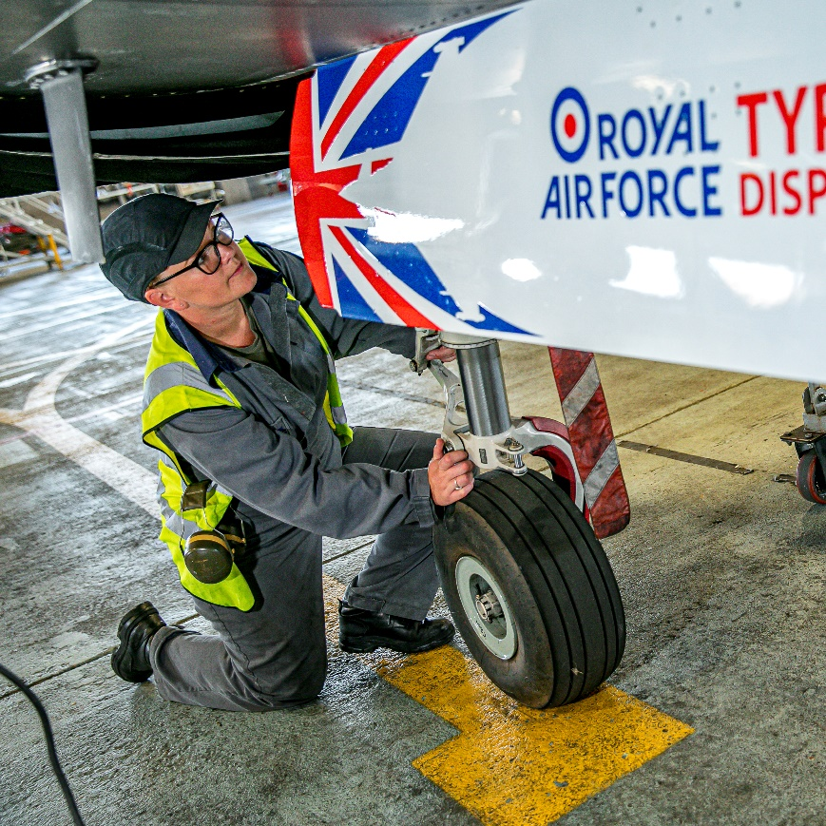
Welcome to the WISE webinar
Corporal Katey Rowe
Notes:
First I’d like to introduce Corporal Katey Rowe, Aircraft Technician & Mechanical Instructor for the RAF

Slide 11




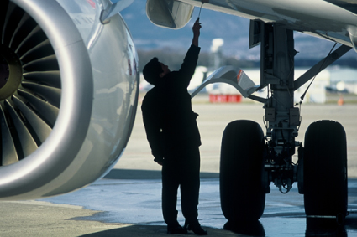

Pre RAF:
Before I joined the RAF I gained my GCSEs and I went to college to try and become a lawyer, I quickly realised this was not for me.
My brother had joined the RAF a year previously and I said how much I would enjoy it.
Within months I was walking through the gates of Halton as an aspiring aircraft engineer and 13 years later I am still here.

Slide 12
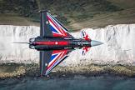
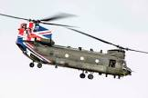

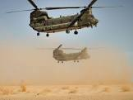

My time in the RAF so far:
Training Feb 2009-Oct 2010
RAF Odiham Oct 2010- Nov 2012
DCAE Cosford Nov 2012- Jan 2013
Typhoon maintenance facility Jan 2013- Sept 2017
Typhoon Training Facility Sept 2017- present

Slide 13
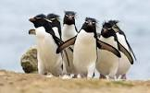
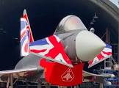



My best bits:
I can honestly say I love my job.
The opportunities: Sport, Travel, Education, FD, display team
The detachments: Afghanistan, Oman, The Falkland islands,
Variety of job role: Depth, Front line Squadron, Teaching

Slide 14
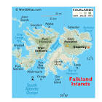


My biggest challenges:
My 1st tour of Afghanistan, it was my first ever detachment with the RAF.
My tour of the Falkland islands, as it was my first FLS detachment on typhoon
Oman due to the different job roles and the pressures from the job role I was doing.
My job at the minute, trying different ways to try and get a student to understand the system, but when they finally get it, it is one of my biggest accomplishments

Slide 15
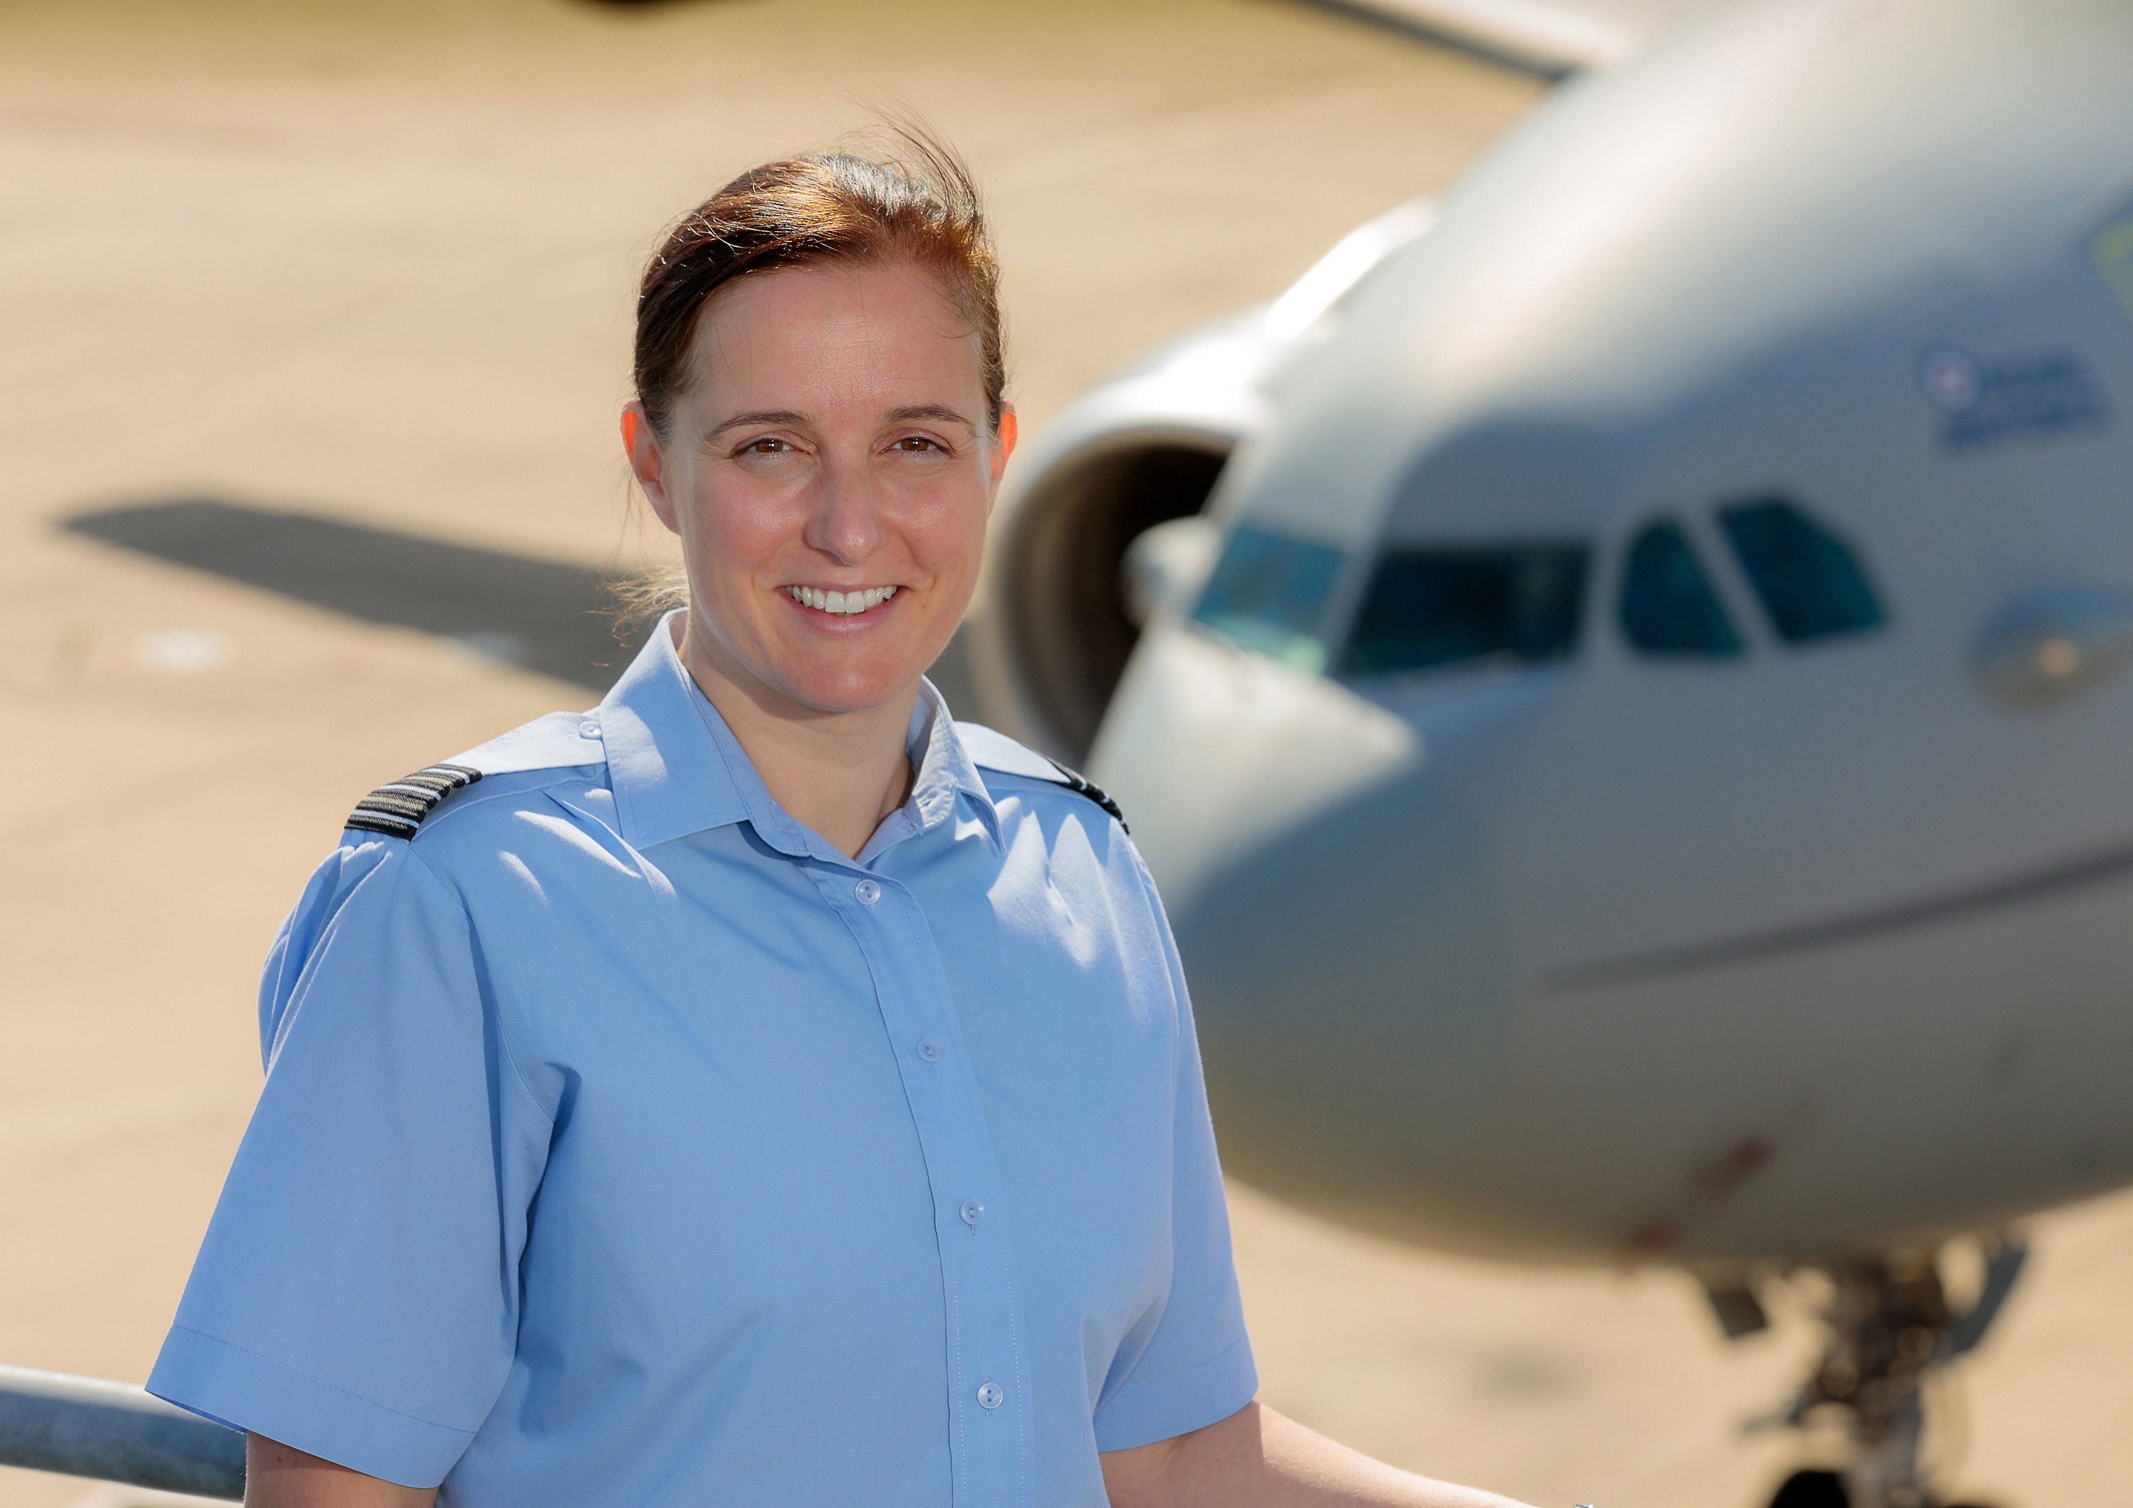
Welcome to the WISE webinar
Group Captain Liz O’Sullivan
Notes:
Now I’d like to Introduce Group Captain Liz O’sullivan, currently posted to Rolls Royce on secondment

Slide 16






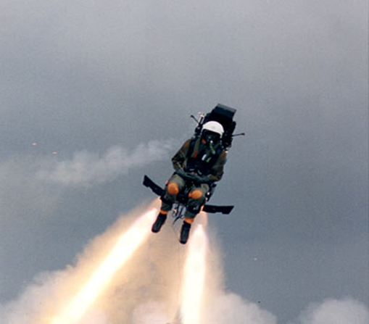
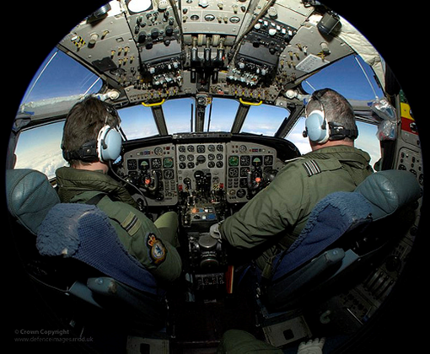
MY BACKGROUND & ROLE
Education:
GCSEs, A-levels and Masters Degree.
Completed Industrial placements:
Former British Steel and Rolls Royce.
Aero-systems (AS) Engineer deals with the RAF’s cutting edge aircraft and equipment:
Armaments, avionics and propulsion systems of all kinds of aircraft, their airborne communications and the ground support that goes with them.
Additional ‘outside role’ appointments.
Move job every 2-3 years.

Slide 17
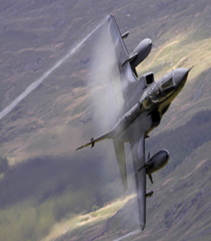
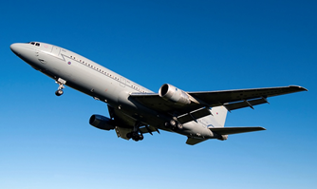
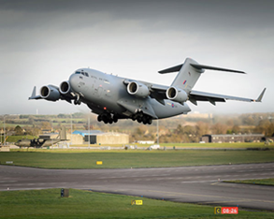
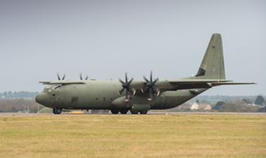
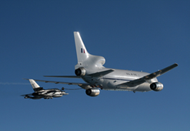
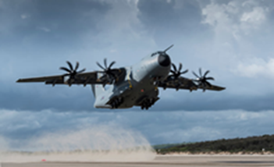


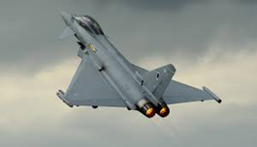

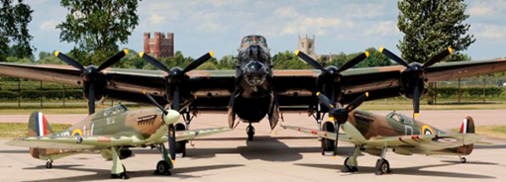
MY CAREER TO DATE
Front Line:
OC Eng Co-ord & Plans and JEngO 6 Sqn (Jaguars).
SEngO 216 Sqn (TriStar).
OC Eng & Logistics Wg (Air Mobility Force).
Staff roles:
HQ 1 Gp A4 support to Typhoon and BBMF.
Typhoon Systems Integration Head and Military Aviation Authority.
Out of Branch:
Staff Officer to Chief of the Air Staff.
Directing Staff on Advanced Command and Staff Course.
Secondment to Industry (Rolls-Royce).

Slide 18
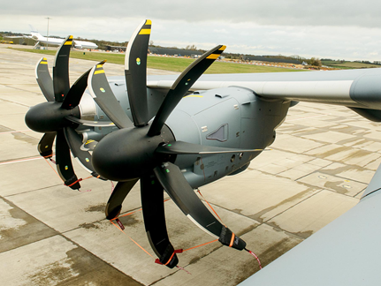
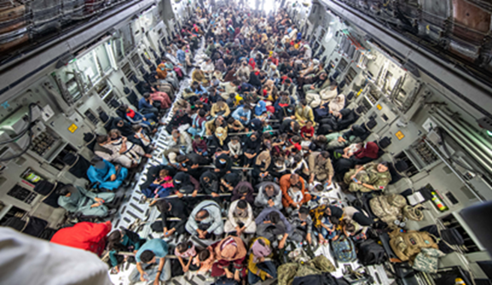

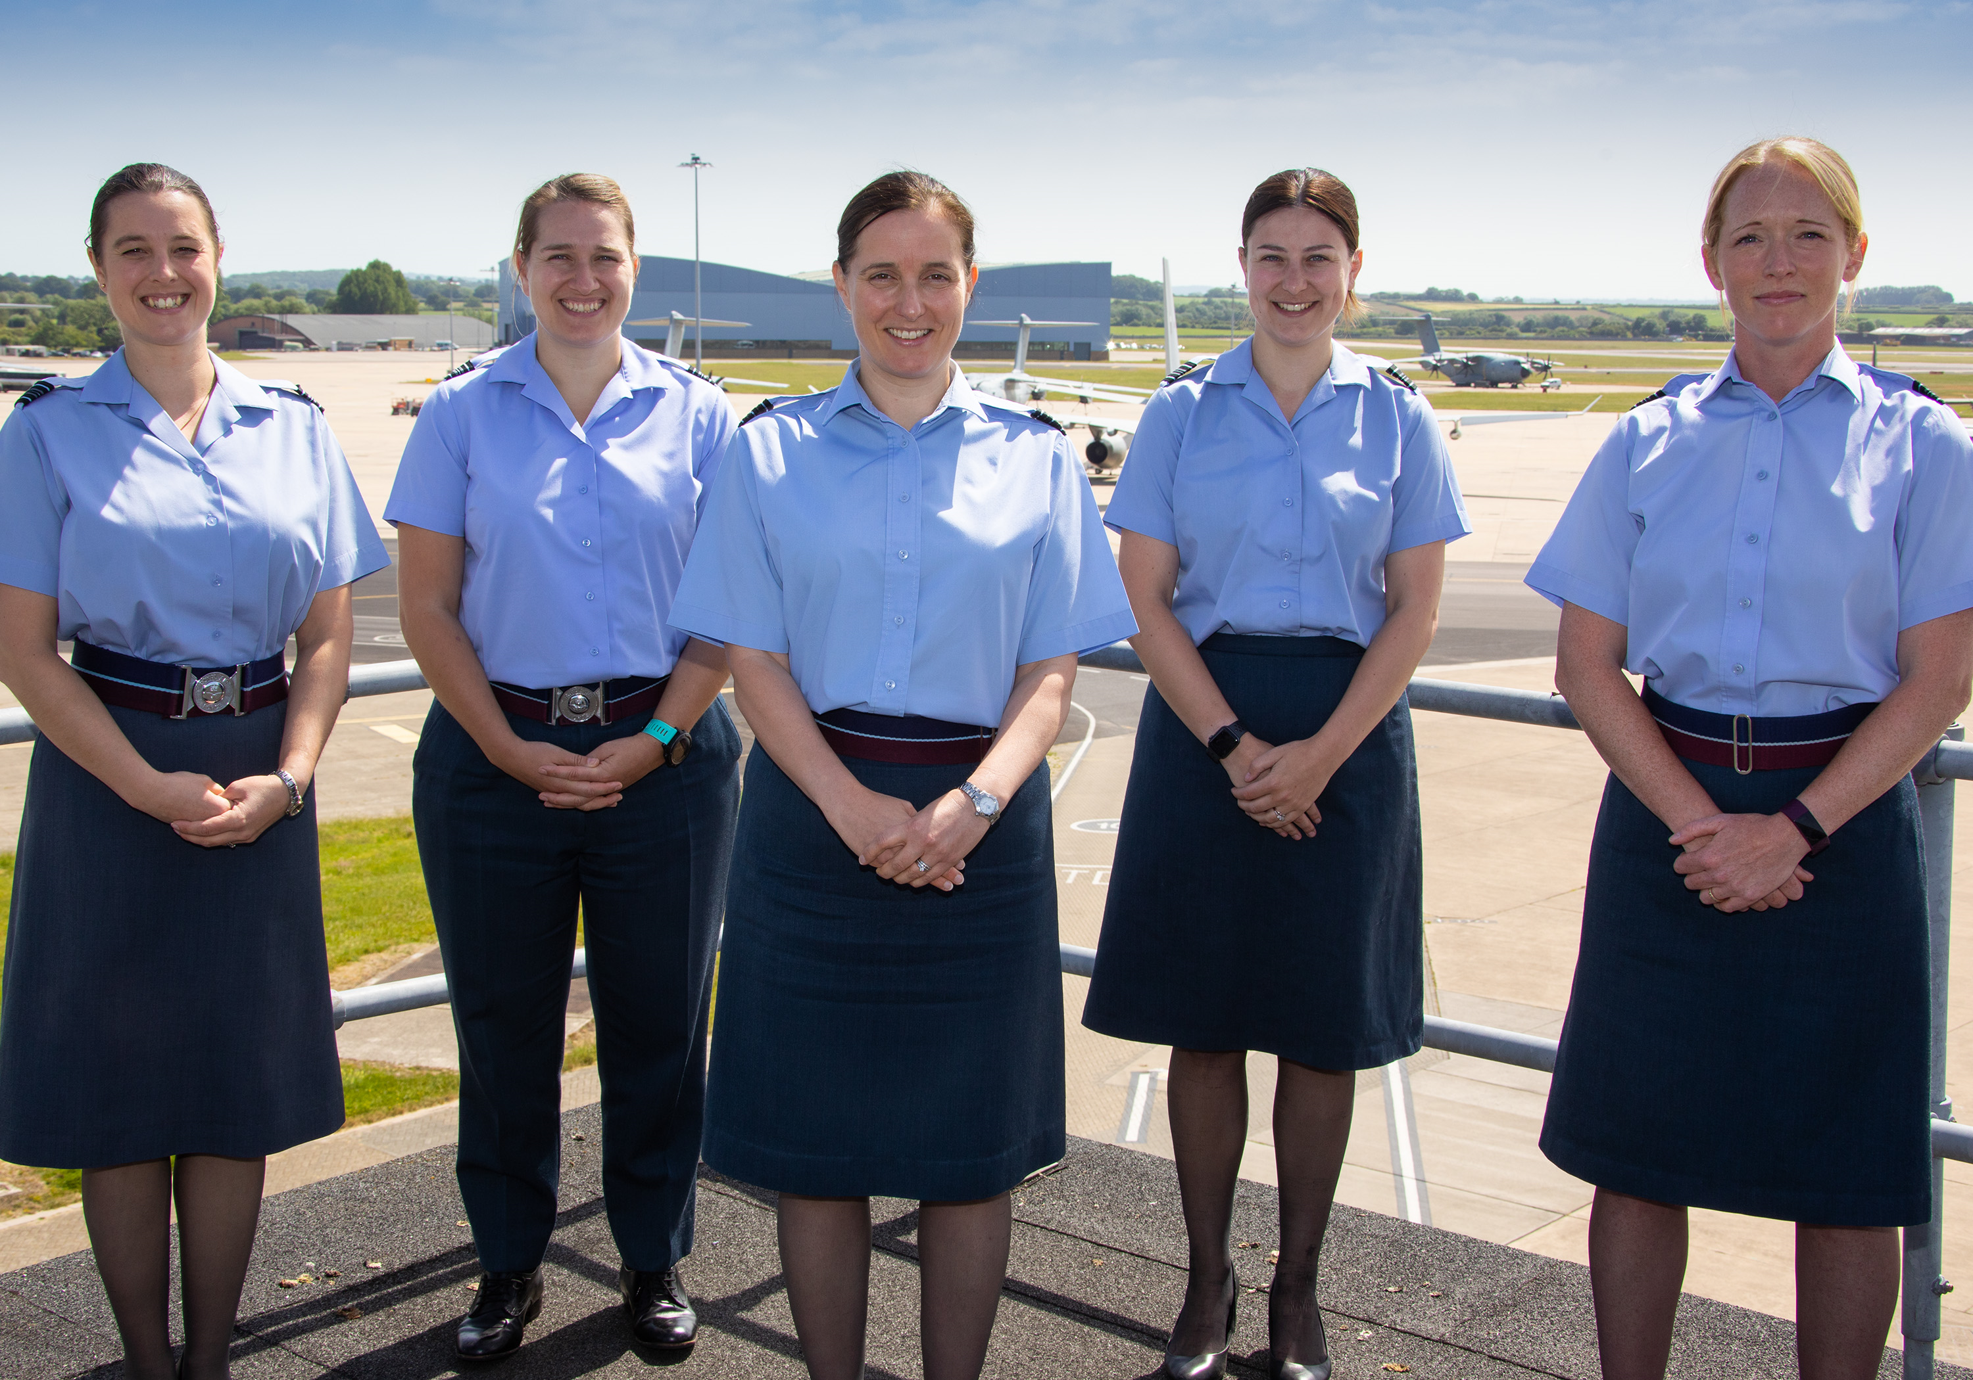
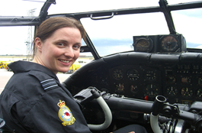
BEST ‘BITS’ & CHALLENGES
Responsibility:
Airworthiness, operational output, personnel and finance.
Variety:
Diversity of aircraft, role and location.
Opportunity:
Travel, education, sport and experiences.
The people.
`````````````````````````I GENUINELY LOVE WHAT I DO

Slide 19
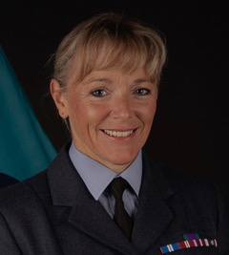
Welcome to the WISE webinar
Squadron Warrant Officer Clare Horler
Notes:
And finally, I’m please to Introduce Squadron Warrant Officer Clare Horler who is an Aircraft Engineer Technician and Technical Trainer for the RAF

Slide 20
Current RAF Role
Aircraft Engineer Technician
Currently employed as the Squadron Warrant Officer on No.1 School of Technical Training for all Mechanical apprentices undergoing Phase 2 technical training at RAF Cosford, nr Wolverhampton in the West Midlands

Slide 21
RAF Career Path
34 years of Service
Started at RAF Lyneham working on the C130, Hercules aircraft, both 1st and 2nd Line as a Senior Aircraftwoman. She deployed as servicing crew on numerous occasions around the world
After promotion to corporal I managed a Heavy Rectification Team that carried out all depth repairs
In 1999, assigned as the first female trade instructor for the Aircraft Mechanical Trade to the No 1 School of Technical Training at RAF Cosford to teach the next generation of technicians.

Slide 22
Promotion to sergeant, - help set-up the new Training Management Wing at RAF Cosford
2012 was promoted to chief technician and awarded a JHC 2* Commendation.
2013 she deployed to British Forces South Atlantic Islands as SNCO In Charge, Engineering Records on the Joint Force Logistics Unit.
2015 promotion to flight sergeant in she was selected for a Chief of the Air Staff Fellowship and gained a Distinction in her Occupational Psychology MSc (first time a full-time fellowship had been awarded to a non-commissioned candidate)

Slide 23
Area Flight Sergeant Wales and West Midlands for RAF Recruitment and Selection.
Responsible for the recruitment of all new recruits from Gloucester to Stoke-on Trent and from Anglesey to Coventry.
Responsible for STEM engagement and outreach engagement at schools, colleges and universities across the area.
2019 deployed to Al Udeid Air Base, Qatar as 901 Expeditionary Wing, Quality Supervisor Co-ordinator

Slide 24
Benefits & Achievements
Personal and professional training qualifications
RAF Mediator and Diversity & Inclusion Advisor
SEN School Governor at a primary school and has taken great enjoyment of organising many Sqn functions and charity events
Raised more than £6000 for the RNIB.
Represented the RAF in 3 recognised sports (Biathlon, Netball and Golf)
She currently sits as the Deputy Chairperson of the Shadow Engineering Board Area North, which provides support to the Executive Engineering Board of the RAF
She was awarded the Meritorious Service Medal in 2019

Slide 25
Any Questions?
Notes:
If there’s anything you’d like to know, please ask because if you’re not sure about it – the likelihood is, there will be others feeling the same. No question is a stupid question!

Slide 26
Pre submitted questions
What opportunities has the RAF given you that you really value?
What would you say are the top reasons why you stay with the organisation?
Were your initial perceptions of what working for the RAF would be like the same as the reality? So what has been as you expected? And what has been different?
What do you think other organisations can learn from the RAF and the way they support women in engineering roles and challenge stereotypes?
How has the RAF supported your career development? Do you feel that you had a wide choice of directions to choose from within the RAF?

Slide 27
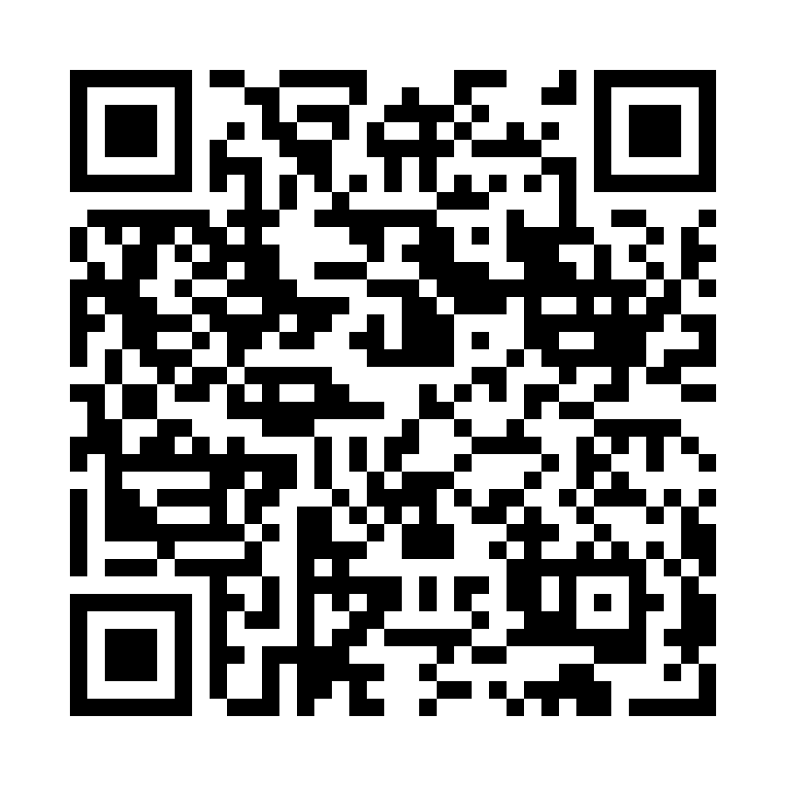
Feedback Survey
Please take a few minutes to complete our feedback survey…
https://www.netigate.se/a/s.aspx?s=1051571X321142724X91478

Slide 28
WISE Events
HRS
https://www.wisecampaign.org.uk/events

Slide 29




WISE Contact Details
0345 527 0889
info@wisecampaign.org.uk
@thewisecampaign
linkedin.com/company/wise-campaign
www.wisecampaign.org.uk
Notes:
Here are our WISE contact details, if you have any questions after today’s webinar or the team can support you with anything – please do get in touch. Otherwise, thank you very much for listening and enjoy the rest of your day.

Slide 30
Notes:
Imagine that you’re a 12-year-old child and I’d like you to take 30 seconds to imagine a picture of a scientist and put some comments in the questions box about what your scientist looks like. What particular features do they have? How old are they? What do they wear? What hobbies do they have?

