Slide 1
An Introduction to WISE
September 2024

Slide 2



FROM CLASSROOM TO BOARDROOM
We work at every stage of the STEM pipeline, identifying the key areas where we can make the biggest difference
INSIGHT & KNOWLEDGE
Generating and sharing fresh insight and knowledge about the causes of and solutions to gender imbalance in STEM
COLLABORATE, CONNECT & AMPLIFY
Developing our members to be the leaders, role models and champions of gender balance in STEM
Notes:
WISE are a membership organisation, providing business to business networking and services to members, partners, educators and training providers. WISE work with businesses to improve their gender balance through a number of different methods:-
Conducting innovative research, sharing knowledge and using this to address EDI issues.
Undertaking benchmarking through the WISE Gender Equity Framework and associated diagnostic tool,– asking organisations to question what they are doing to help improve their gender balance and looking at cultural change and allowing companies to see how they compare to their competitors
Offering networking opportunities through webinars, knowledge sharing events and other annual events such as the Measuring Progress Event and the CXO Breakfast.
WISE work with members and other organisations to seek out best practices within the STEM sector and share these with everyone
Delivering training sessions in diversity and inclusion, unconscious bias, recruitment practises and more.
Supporting outreach through the My Skills My Life programme

Slide 3
Get Involved with WISE!

Slide 4
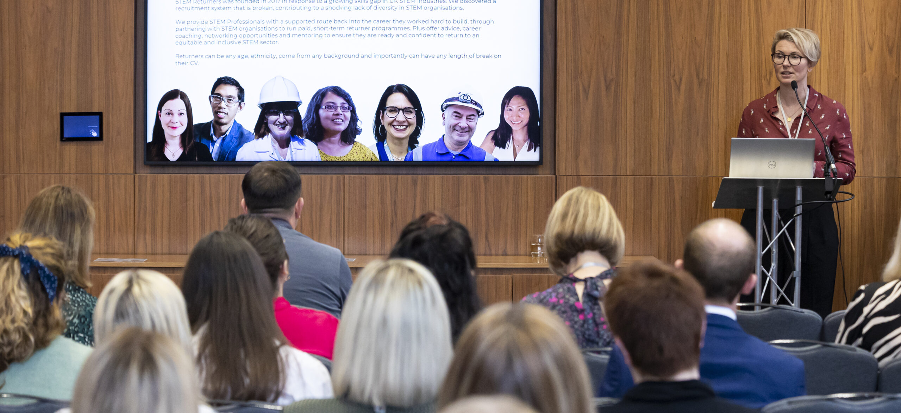
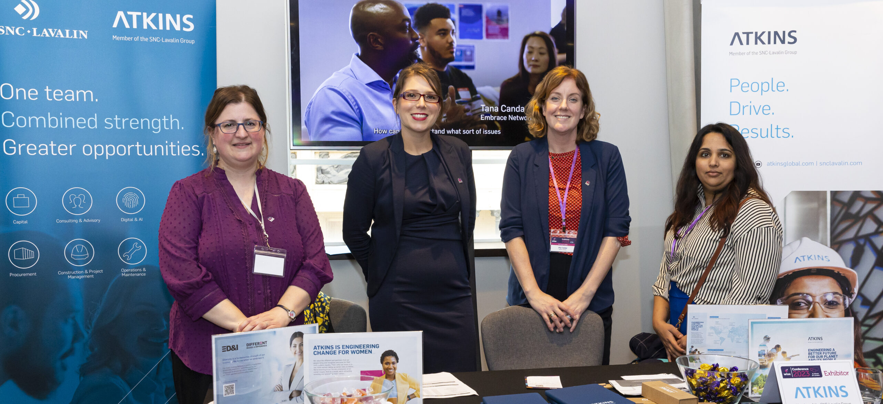
WISE Member Events
Free, unlimited attendance for all employees at our:
Knowledge Sharing Events
Webinars
CXO Roundtable
Measuring Progress Event
International Women’s Day & International Women in Engineering Day Events
Previous member events:
Working with the Menopause
Empowering Neurodivergent Women
Leveraging Data for EDI Success
How to Overcome Imposter Syndrome
Notes:
WISE Events page: https://www.wisecampaign.org.uk/events/
Need to be registered on WISE member area to register for WISE events – this is free for all employees, details of this on next slide

Slide 5
WISE Online Member Area
Free, unlimited access for all employees at the organisation
Exclusive WISE Member Case Studies sharing best practice in EDI
Regular updates to gender focused statistics from the workforce, GCSE, A Level and gender pay gap data
WISE’s bespoke research and findings
Previous recordings of WISE Member webinars and online events
WISE news and blog posts
Notes:
Link to registration page: https://www.wisecampaign.org.uk/registration/
Unlimited registrations on the website for employees

Slide 6
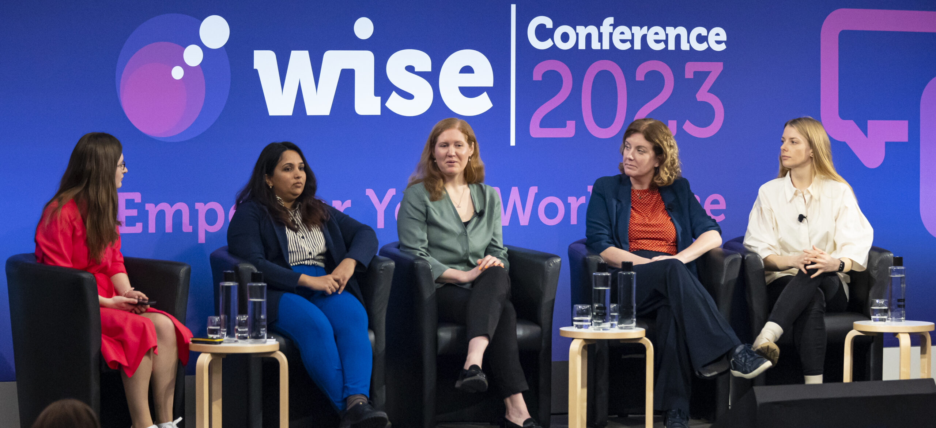
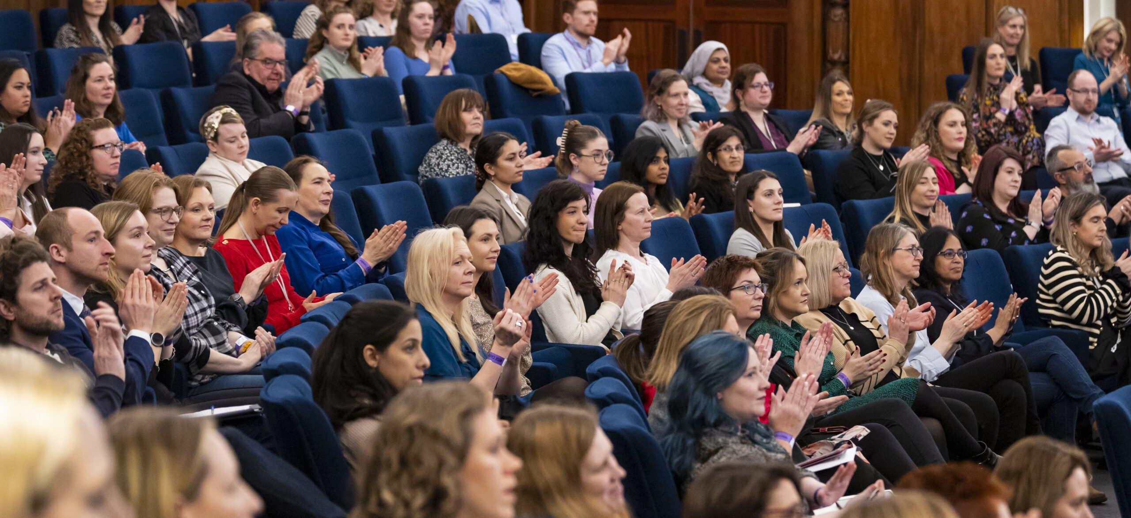
WISE Leading Events
WISE Conference:
Discount on tickets for employees
Keynote speakers, panel discussions and breakout sessions
Networking opportunities throughout the day
WISE Awards
Recognising incredible women, allies and organisations across STEM
Nominate your peers or yourself!
Evening event to announce and celebrate the winners
Notes:
WISE Events page: https://www.wisecampaign.org.uk/events/
Need to be registered on WISE member area to register for WISE events – this is free for all employees, details of this on next slide

Slide 7
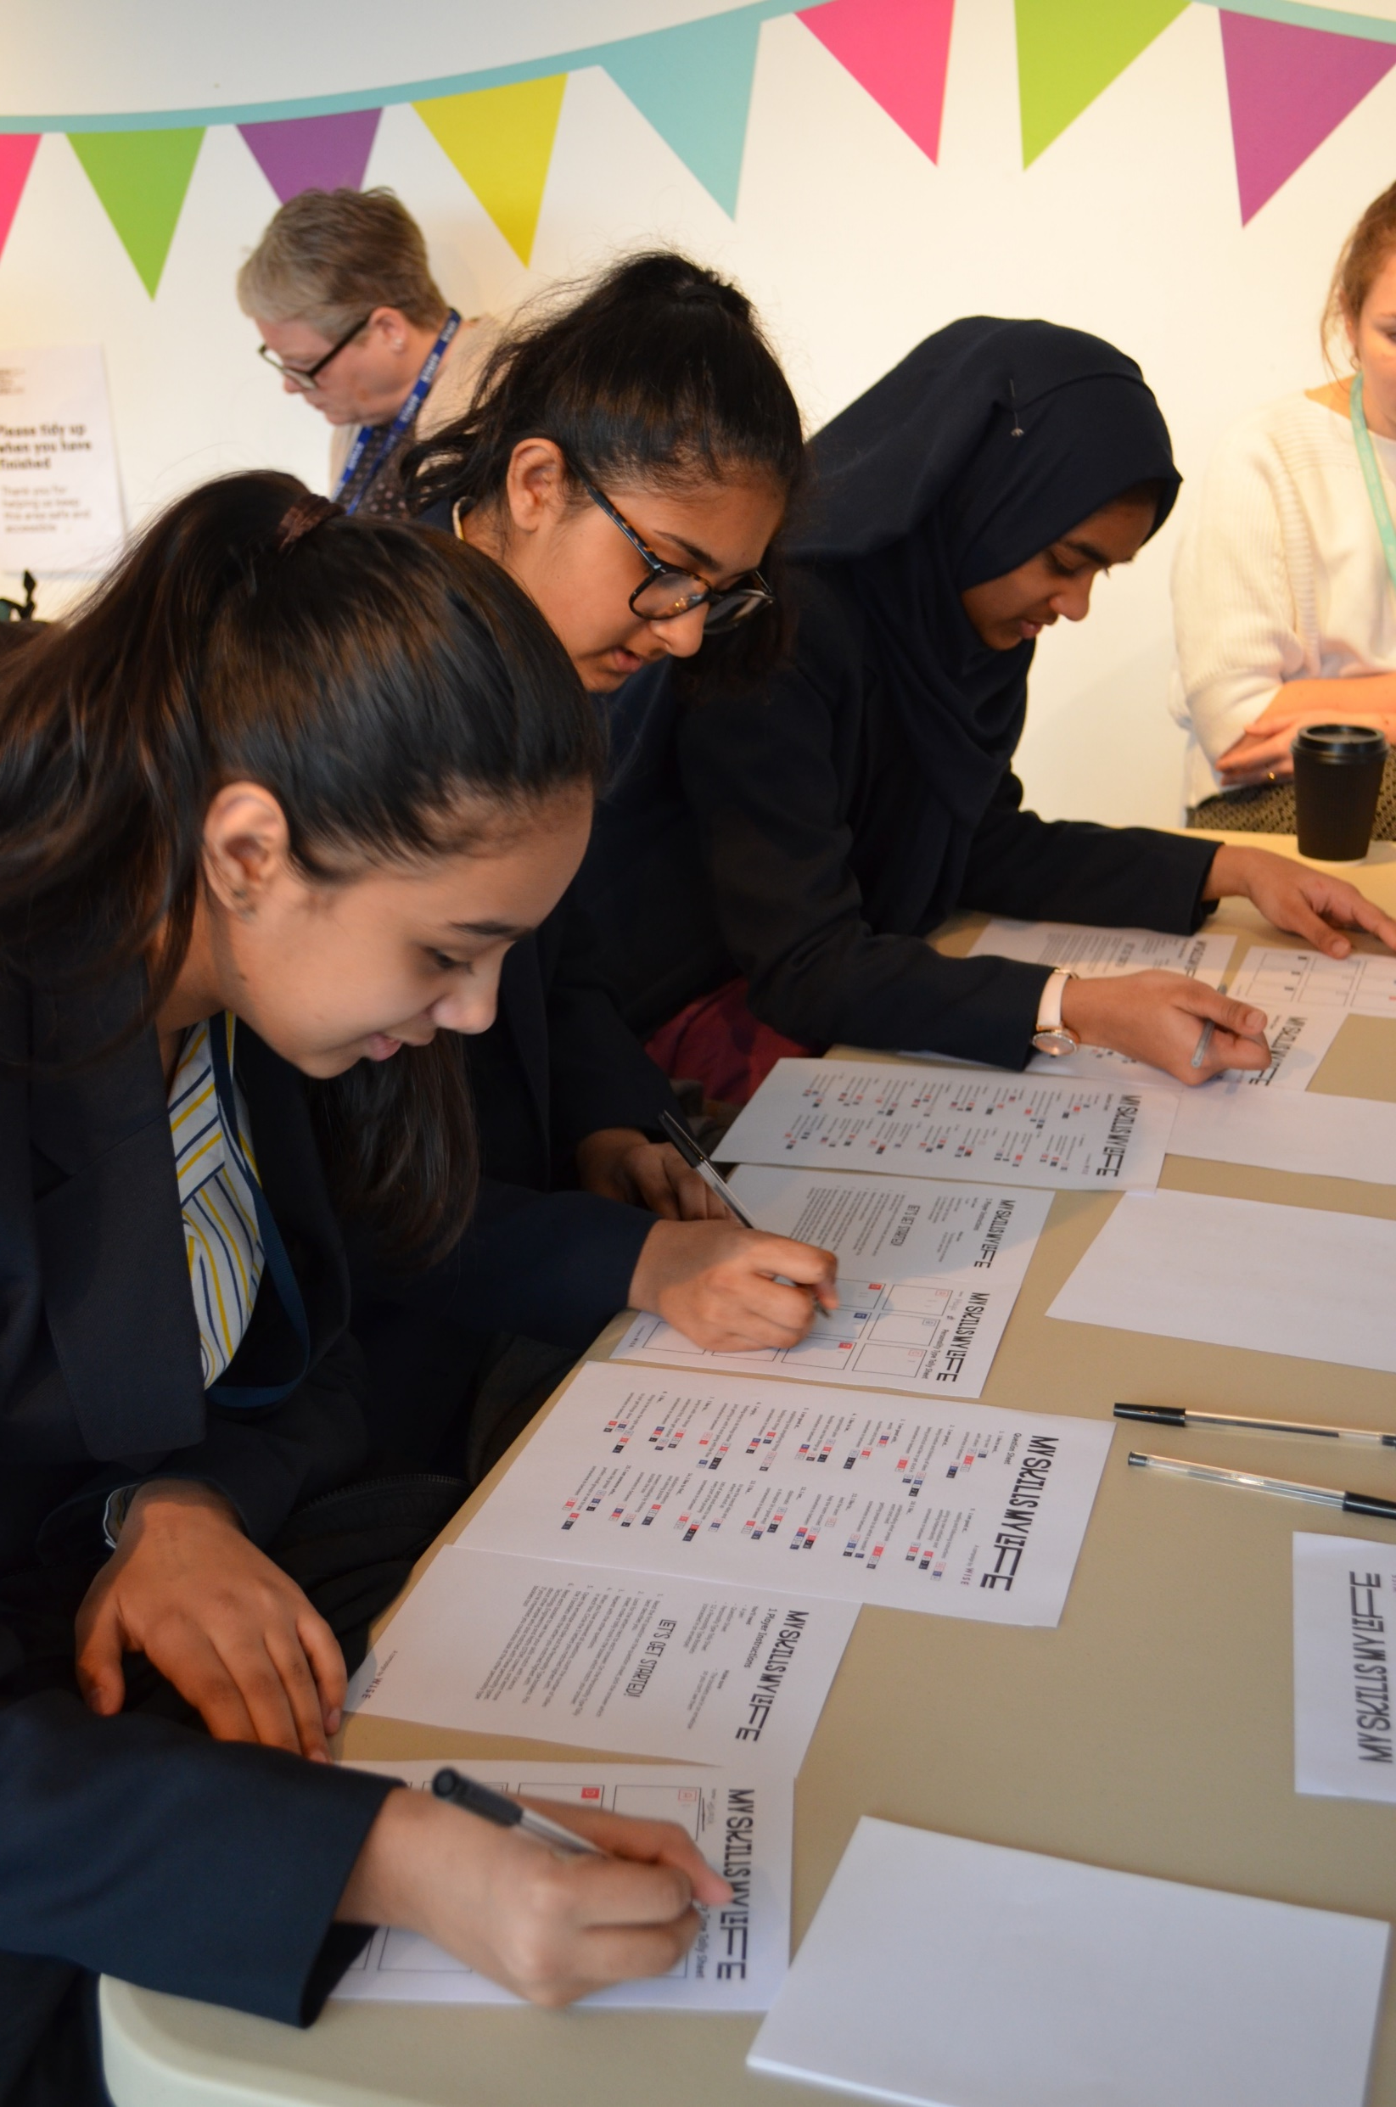
My Skills My Life
My Skills My Life is WISE’s outreach resource that supports the recruitment of girls into STEM subjects post-16
‘Pick up and go’ resource for use in schools, community groups & at events
Online platform with over 1,200 role models – women working in STEM
Facilitates the conversation around STEM careers
Offer training workshops in delivery of the resource
Notes:
My Skills My Life is an outreach tool that WISE have developed, aimed at girls ages 11-19 – although the resource has been extensively tested in Primary Schools and with mixed groups too. My Skills My Life aims to increase the number of girls who take a STEM subject post-16. This is especially important for subjects such as physics, engineering and computing.
As a resource, My Skills My Life has been designed for both organisations & individuals to use in their outreach work. One of the WISE taglines is ‘from classroom to boardroom’ – in order to make real change in the STEM sector, we need to be supporting the entire pipeline, which begins in education. The resource has been designed as a ‘pick up & go’ tool for use across the country.

Slide 8
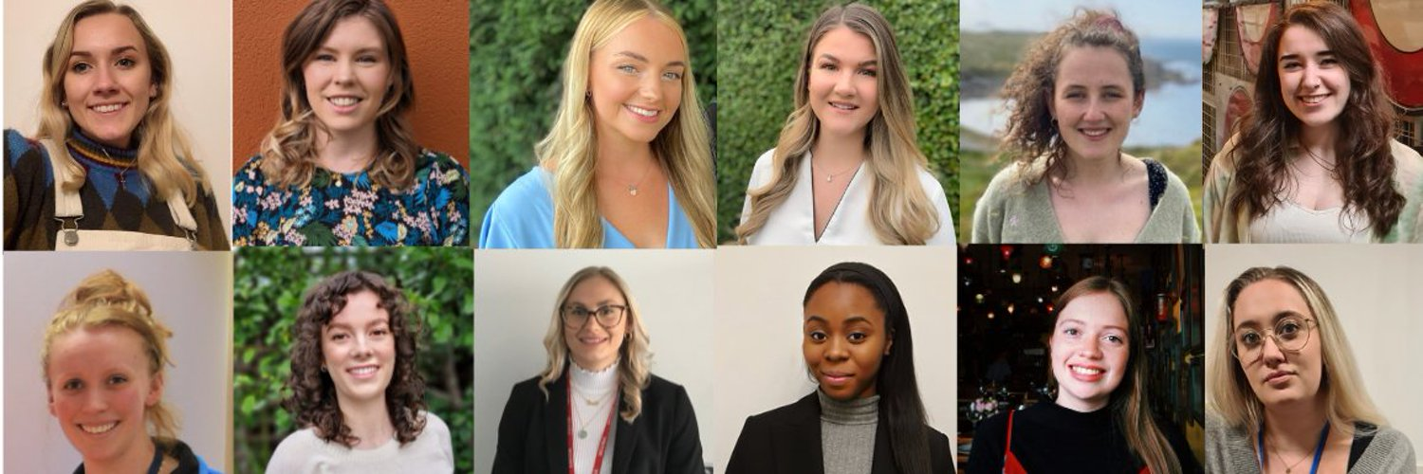
WISE Young Professionals Board
The WISE Young Professionals Board is a group of diverse exceptional young role models.
WISE members can put forward young talented women to apply for a position on the board.
WISE YPB activity includes:
writing blogs, new stories & resources
collaborating with Harper Collins on educational materials for primary age students,
coordinating competitions and producing social media content,
representing WISE at events.
Notes:
The WISE Young Professionals’ Board is a group of diverse exceptional young role models working at a variety of WISE member companies in the UK.
They pride themselves in representing a wide range of backgrounds, educational routes and industries, allowing them to authentically champion, engage with, support and represent the 1 million strong UK workforce of women in STEM.
As a group of passionate young diverse professionals in STEM they are catalysts of cultural change both in our own workplaces and at a national level. They are committed to gender parity in STEM because a diverse workforce will deliver innovative solutions that solve complex and pressing global issues.

Slide 9
WISE Products & Services

Slide 10

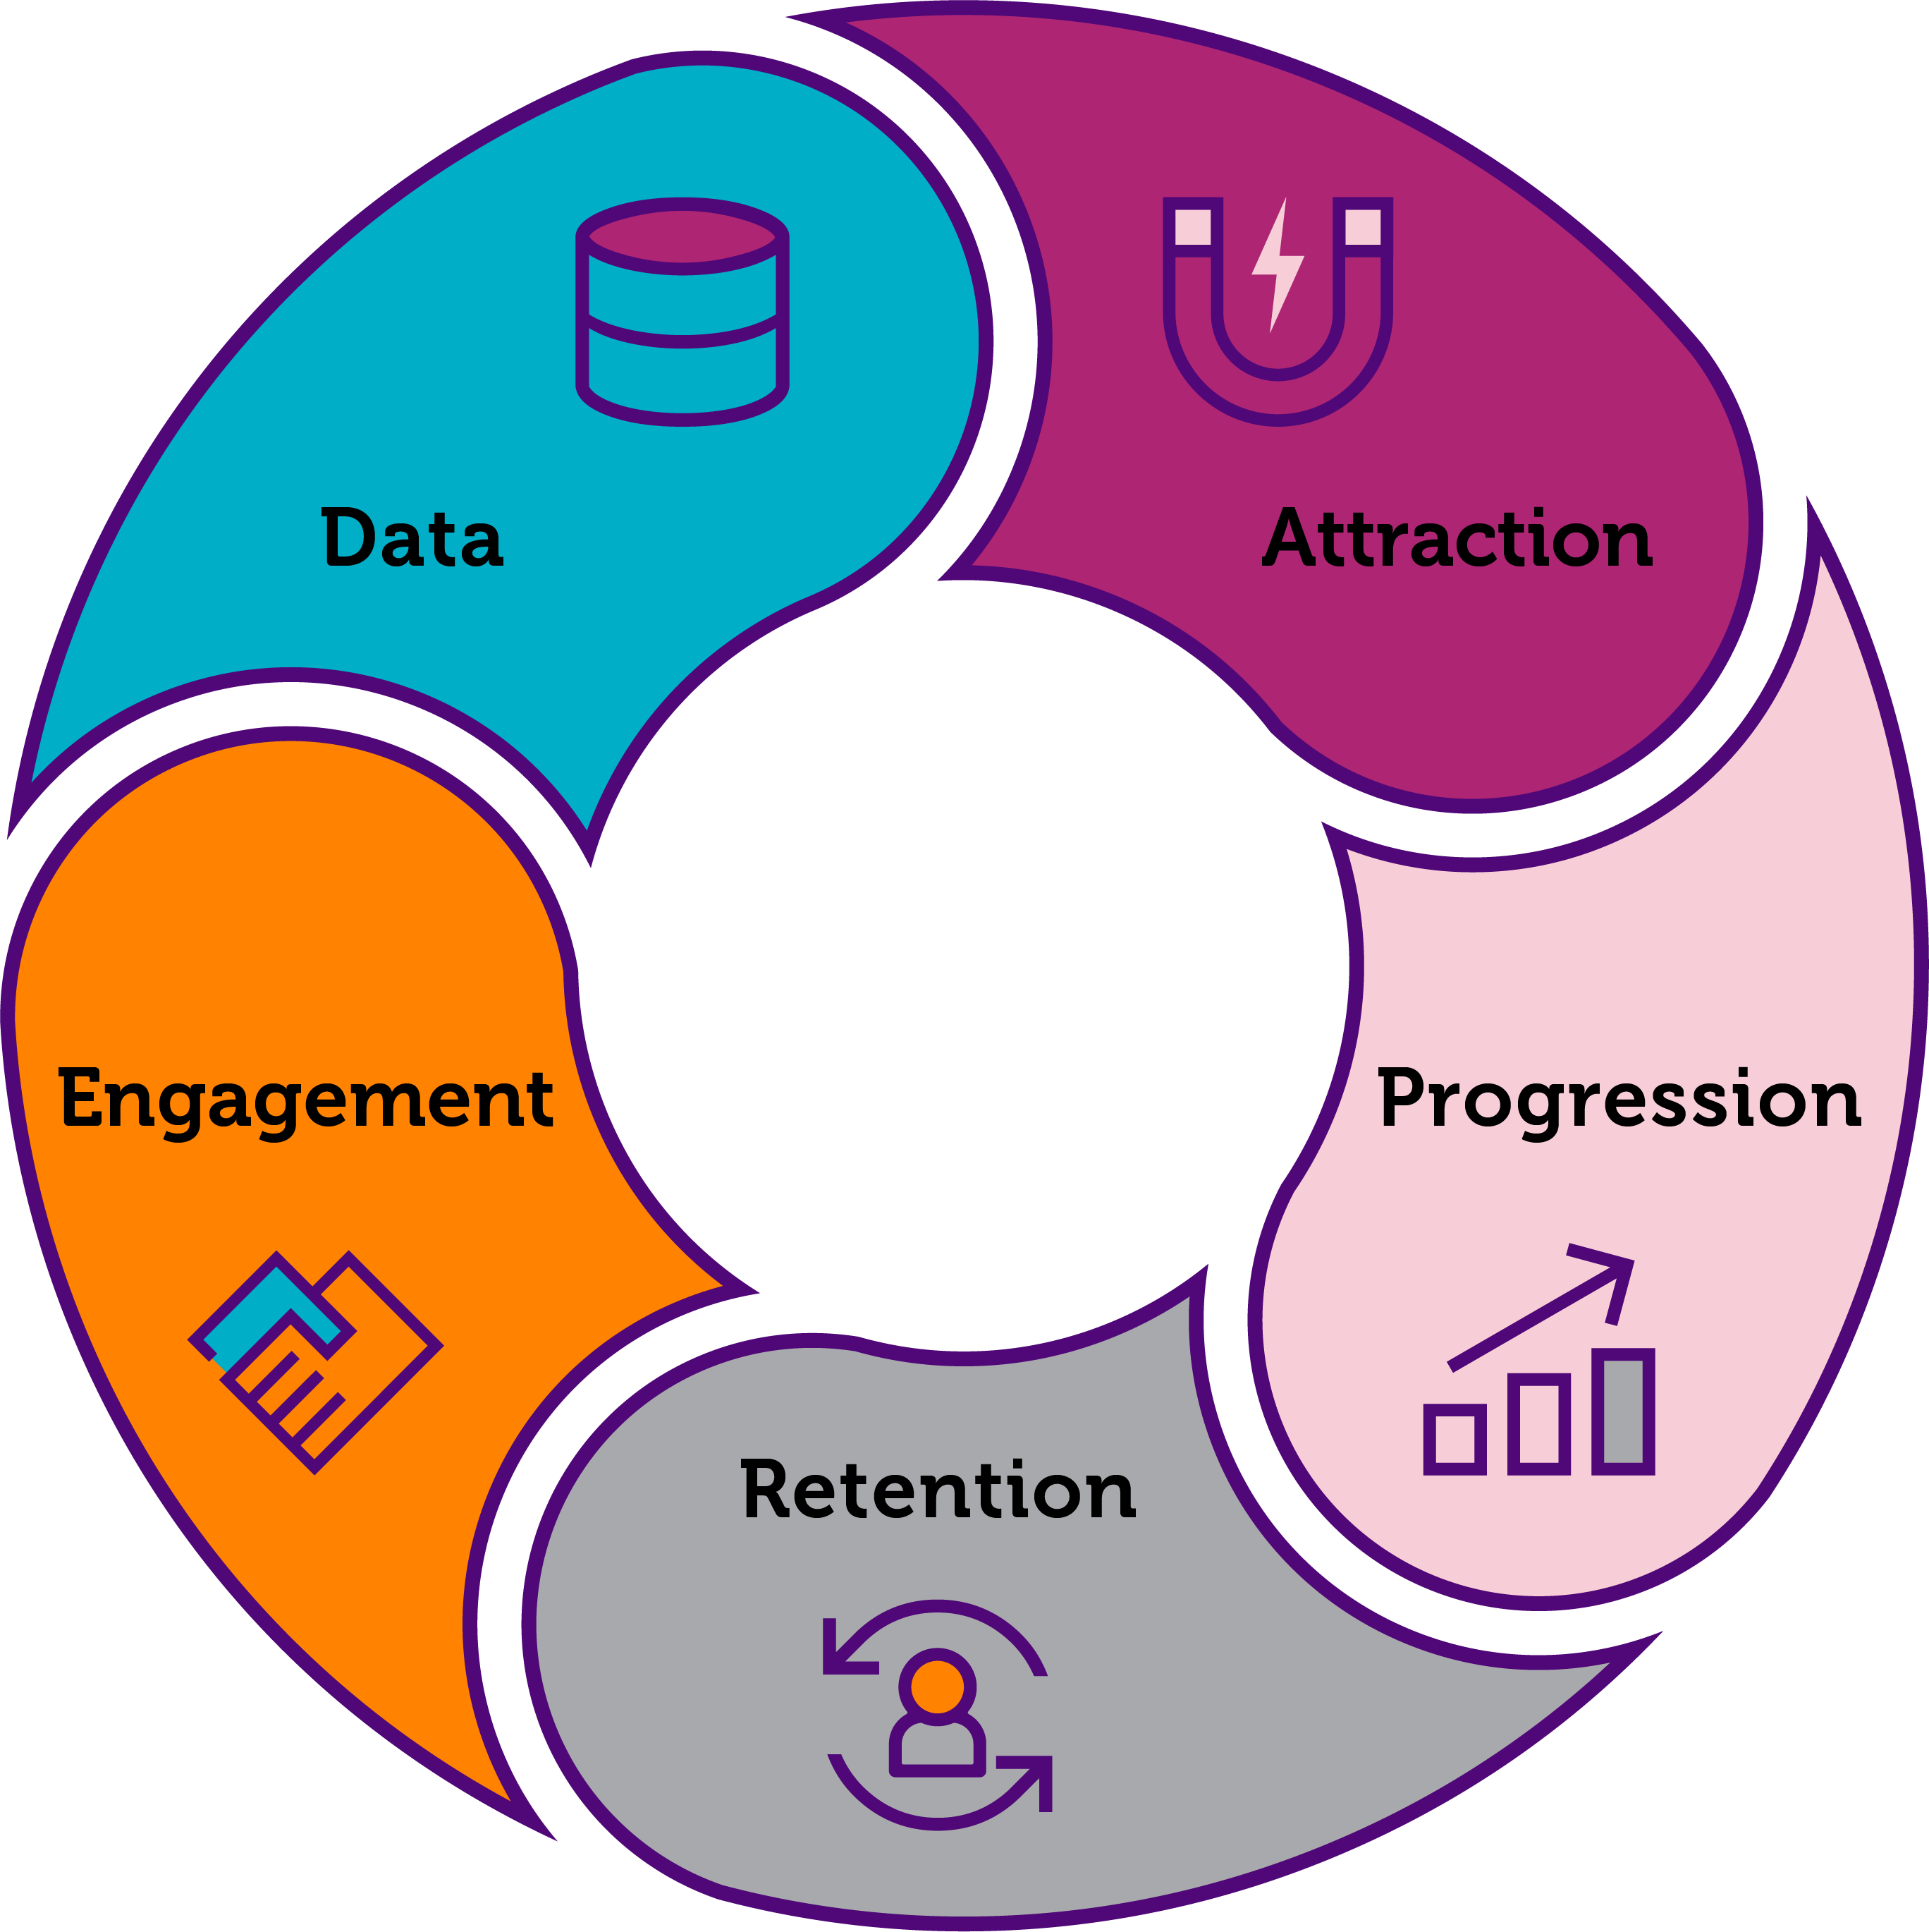
Our framework:
5 pillars
Each pillar contains various supportive sub-headings
Our Diagnostics:
A HR and EDI Lead Diagnostic
An Employee Diagnostic
Notes:
Sub-headings that sit under each pillar: Data: Diversity Data Monitoring, Exit Interviews, Gender Pay Gap, EDI Management, Share Good Practice, Employee Engagement
Attraction: Recruitment, Outreach, Returners, Early Careers
Retention: Sexism and Discrimination, Family Friendly Policies, Flexible Working, Reasonable Adjustments, Parental Leave, Hybrid Working, Returners, Women’s Health
Development: Transparency in Progression, Sponsoring Women
Retention
Engagement: Leaders and EDI, Employee Networks, EDI Communications,

Slide 11
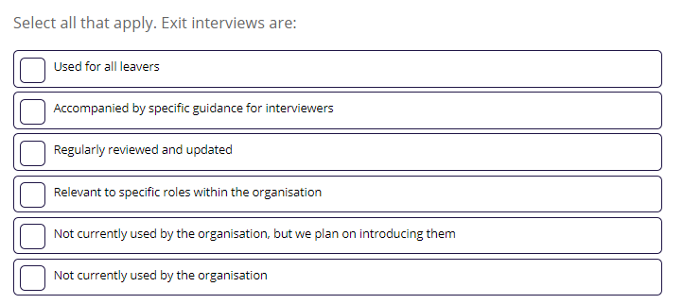
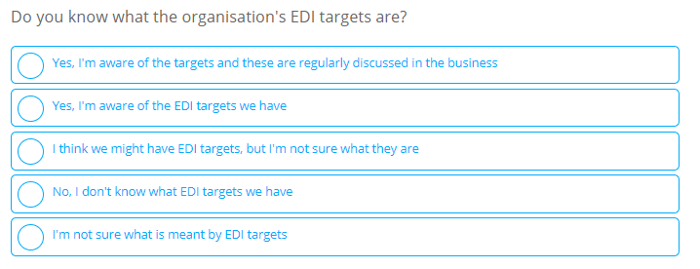
The diagnostics
HR Diagnostic:
Completed by EDI/HR Professional(s)
More in-depth and longer
Focused on policies, procedures and structures
Employee Diagnostic:
Shared for completion by employees
Less onerous and technical
Focused on employee experience of EDI
35% of total diagnostic

Slide 12
Training & Support Measures
WISE Gender Equity Framework Workshop
Introduction to Diversity & Inclusion
Inclusive Recruitment
Unconscious Bias
Allyship
Reverse Mentoring
Employee Webinars
Outreach Delivery
Bespoke Projects and Consultancy Services
Notes:
Link to WISE Training & Support Measures page: https://www.wisecampaign.org.uk/training-workshops/

Slide 13

Contact Us
For any inquiries or assistance getting involved with WISE, please contact us:

